Slide 1
NCHMA 2024
Annual Conference
September 5, 2024

Slide 2
NCHMA 2024
Annual Conference
September 5, 2024

Slide 3
Vanessa Rupertus
Software Engineer Ribbon Demographics LLC

Slide 4
The Old Process
1
2
3
4
5
CLIENT SENDS REQUEST
RIBBON MAPS REQUEST
CLIENT APPROVES MAP
RIBBON CREATES REPORTS
We extract the data from the mapped area and format it into easy-to-read and informative excel sheets.
RIBBON SENDS REPORTS
A client sends us a data request via email or phone call
We map the area desired and send the map to the client for approv- al.
If all goes well, client approves us to move forward! Otherwise, we make adjustments to the map.
We email the reports to the client alongside an invoice for the reports.

Slide 5
The New
Ribbon!
03
CLIENT FILLS FORM
Similar to an email, the client provides details such as the market area, the geographical level, and the reports desired (if applicable).
02
04
CLIENT SELECTS REPORT TYPE
The user selects the report category (no mapping)! They can also launch our ribbon map to map the project themselves (mapping).
APP CREATES REPORTS
Our application takes your information and generates the reports you selected on the spot!
01
05
CLIENT SIGNS INTO APP
Once the user is signed in, they have numerous reports / options to choose from!
APP PROVIDES REPORTS
Once generated, the applica- tion will provide download links to each report. Don’t worry! They’re available on the user dashboard until you delete them.

Slide 6
The Benefits
01
USER CONTROL AND FASTER TURNAROUND
User has more control over the creation process
Faster turnaround time with fewer emails!
02
ALL RESOURCES CENTRALIZED
The Ribbon DAS keeps all your reports in one place
Create new report option is also in the same place!
Payment made easier, right through the app
03
TEAM FRIENDLY ENVIRONMENT
Manage your employees by creating teams!
Teams can see reports they made as well as their fellow teammates

Slide 7
Live Tutorial Click Link to Play

Slide 8
Lubna Fatima
Software Engineer

Slide 9
Working On
For Sale Analysis
Rent Comparability studies express platform
API Integration for Our Various Data Partners

Slide 10
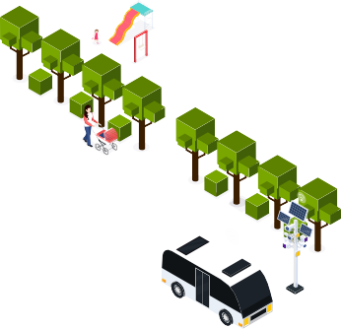
For Sale Analysis
Evaluates income-eligible home buyers at different price levels.
Considers factors like current interest rates, household income, and demographic conditions.
Assesses the conversion of renters to owners and transitions within the ownership market (downgrade/upsize).

Slide 11
Data Source
Interest Rate & Percentage of Annual Movers:
Update Frequency: First business day of each month.
Source: Internal data or specific financial databases.
%
Demographic Statistics:
Update Frequency: Annually
Source: Claritas, U.S. Census

Slide 12
Demo
Demo Link

Slide 13
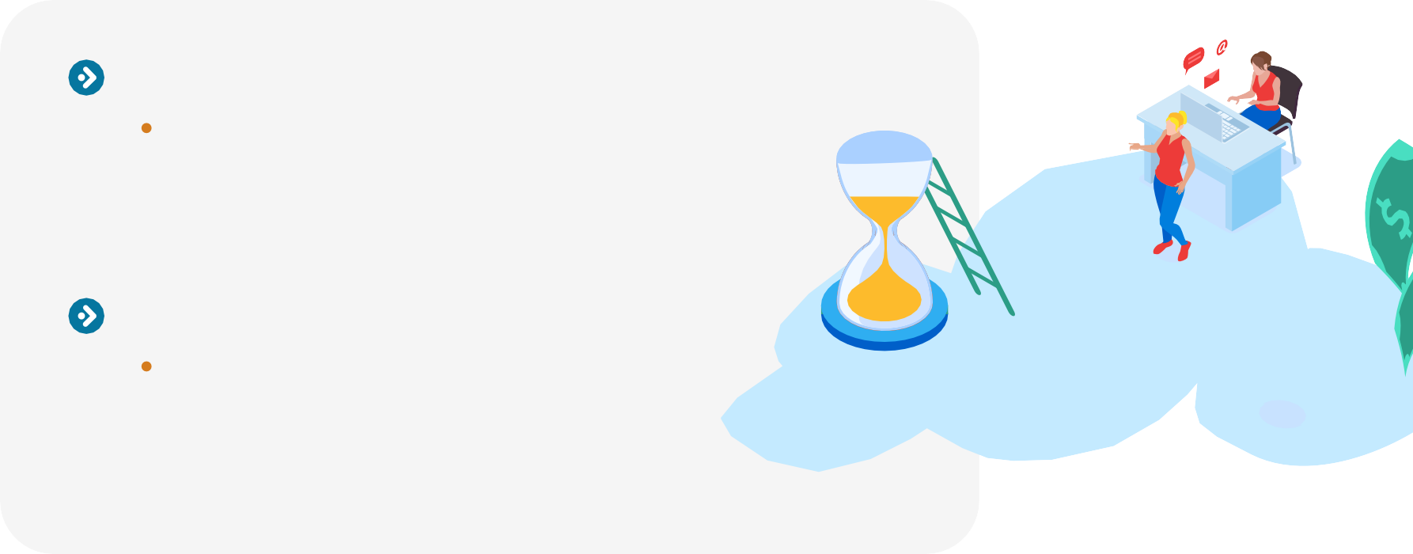
Value for Market Analyst
Time Efficiency:
Reduces Analysis Time:
Significantly cuts down the time required for market analysis, providing results in less than a minute.
User-Friendly Interface:
Calculator-Like Functionality:
The application operates with the simplicity of
a calculator, making it easy for users to perform complex analyses without extensive training.

Slide 14
Future Scope
Mobile Application:
Accessibility on the Go:
Develop a mobile app to provide users with the ability to perform market assessments anytime, anywhere.
Expanded Data Integration:
New Information from Data Vendors:
Incorporate additional data to enhance analysis capabilities, including deeper insights into community dynamics and quality of life.

Slide 15
Contact Details
S C H E D U L E T I M E T O C H A T !
Scan the QR Code
Lubna Fatima
lubna@ribbondata.com

Slide 16
Kalaiarasi Kaliappan
Data Scientist

Slide 17
AI/ ML
Artificial Intelligence (AI)
What it is:
Teaching computers to think and make decisions like humans.
Machine Learning (ML)
What it is:
A part of AI where computers learn from data to get better at tasks over time.
Example:
Voice assistants like Siri or Alexa.
Example:
Voice assistants like Siri or Alexa.
Key Point: ML is a way of making AI smarter by learning from data.

Slide 18
Traditional Approach
RIBBON
DEMOGRAPHICS
Hire a Part-Time or Full-Time Market Analyst to Provide Support as Your Organization Grows
Training Salary Benefits
On-Going Management Administrative Costs

Slide 19
Process
Step 1
Step 2
Step 3
Algorithm Reads Database
Data Cleaning and Analysis
Data Visualization

Slide 20
Process
Step 4
Step 5
Step 6
RIBBON
DEMOGRAPHICS
Summary Generation
Preparation of Reports
Make Reports Accessible to Users

Slide 21
ChatGPT v. Ribbon VA
RIBBON
DEMOGRAPHICS
Versatile across various topics and applications
Highly specialized for specific tasks

Slide 22
SOURCES YOU CAN TRUST

Slide 23
Demo
Demo Link

Slide 24
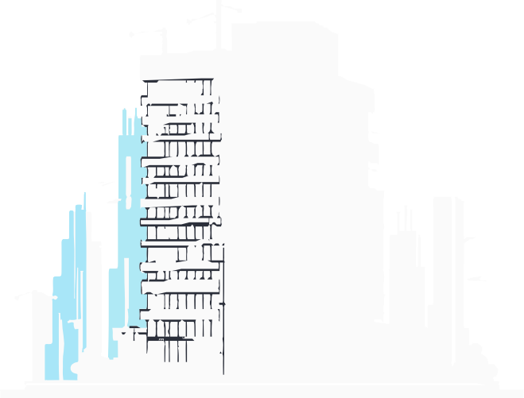
Why Ribbon?
SPEED
Better-informed decisions quickly and efficiently Creates a competitive advantage for market analysts Improves the probability of on-time delivery
OBJECTIVE EVALUATION
Ribbon will review market trends and evaluate opportunities
Offers a fresh perspective on data to drive strategic business decisions
OFFERS A SCALABLE SOLUTION FOR ORGANIZATIONS
Automate redundant tasks to spend more time on higher level activities

Slide 25
What’s Next for Ribbon…
Virtual Analyst (Ribbon V/A) -
Automated Voice & Text Generated Analysis v1.1
V/A will Summarize Market Study Components
Provide a Summary of Local Property Competitors (Vacancy Rates, Local Rents, Unit Mix Distribution)
Recap Demand Analysis to Address Concerns or Positive Attributes Discuss Development Pipeline
Summarize the Penetration Rate Results
Make recommendations
Neighborhood Sentiment Analysis
Ribbon V/A will provide a description of the neighborhood using sentiment analysis
Aggregate public reviews about property comps to assist with the property comparison section of a market analysis

Slide 26
Ribbon Solutions Group
RIBBON
DEMOGRAPHICS
Optimize your Existing Infrastructure Customized Solution for Enterprise Customers with Unique Processes
Preliminary Conversation
Design the Process w/ Customer Confirmation Attributes, Inputs, Needs Begin Infrastructure
Schedule Check-Ups Schedule Testing Deploy Solutions

Slide 27
Contact Details
S C H E D U L E T I M E T O C H A T !
Kalaiarasi Kaliappan
kalai@ribbondata.com

